Slide 1

Objectives
During this session you will learn to:
  Identify the features of VTune Performance Analyzer
  Identify hotspots and bottlenecks in an application using sampling
Notes:
Share the objectives with the students.
Ask the following recap questions from the students before proceeding to the next slide:
What is a bottleneck?
What is a hotspot?

Slide 2
Exploring VTune Performance Analyzer
VTune Performance is a powerful and easy-to-use software-analysis tool.
It collects, analyses, and displays performance data for a wide variety of applications.
It can be used to identify and locate the code snippets in your application that show the highest amount of activity over a specific period.
It also displays how an application interacts with the OS or other software, such as drivers.
Notes:
Explain about VTune Performance Analyzer as shown on the slide.
Explain that VTune is a tool by Intel that is used for performance tuning.
Mention that VTune can be used to collect system wide data and application specific data.

Slide 3
Features of VTune Performance Analyzer
Various features of VTune Performance Analyzer are as follows:
  Sampling
  Call graph
  Counter monitor
  Tuning assistant
  Hotspots view
►
  Calculates the actual performance of the system over a period and for various processor events
►
  Provides a graphical view of the flow of an application and helps you identify critical functions and timing details in the application
►
  Provides system-level performance information, such as resource consumption, during the execution of an application
►
  Provides tuning advice from an analysis of the performance data. The tuning advice helps you improve performance of an application
►
  Helps identify the area of code that takes the maximum CPU time
Notes:
Discuss various features of VTune Performance Analyzer with the help of the animations given in the slide.
While explaining about tuning assistant, explain that tuning advice is available only with event-based sampling and counter monitor.

Slide 4
Working With VTune User Interface
VTune Performance Analyzer provides flexible user interfaces.
Using these interfaces, you can manage and organize various windows and analyze views, according to your requirements.
Notes:
In this slide and the next slide, discuss various interfaces of VTune Performance Analyzer.

Slide 5
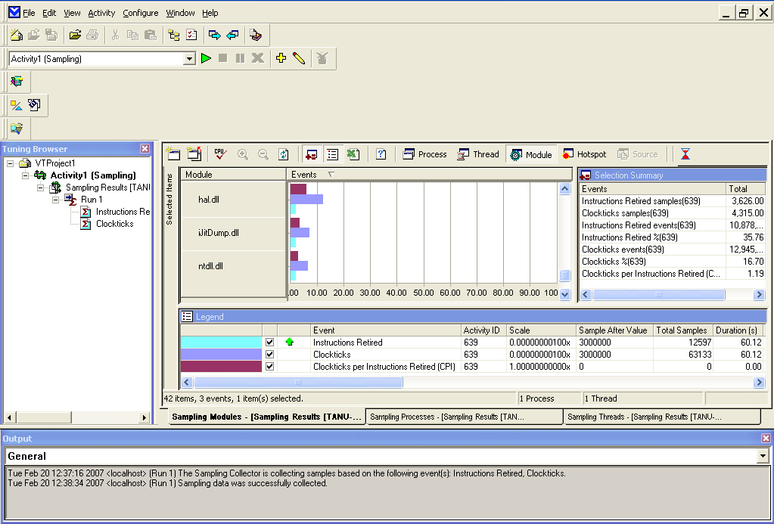
Working With VTune User Interface (Contd.)
Tuning browser: The Tuning Browser window displays a list of the contents of a project. This window enables you to view the result of activities. The Tuning Browser window also enables you to use all the activities related to the project.
Output window: The Output window displays messages during data collection and analysis.
Data view: Data views display analysis data in various formats.
Menus and toolbars: Menus and toolbars provide easy access to the common commands of the VTune Performance Analyzer. Using these commands, you can access the information that the VTune Performance Analyzer provides.

Slide 6
Just a minute
Which data view displays all the threads that run within a selected process?
Which data view enables you to pinpoint problem areas in the code?
Answer:
  Thread view
  Source view

Slide 7
Identifying Wizards in VTune
The different wizards available in VTune Performance Analyzer are displayed in the following table.
Name | Description
Quick Performance Analysis (QPA) wizard | It enables you to quickly analyze your application's performance. This wizard enables you to create an activity with any combination of sampling, counter monitor, and call graph collectors.
Complete setup wizard | It enables you to create an activity and configure multiple collectors at the same time. The wizard prompts you to enter values only for the basic parameters and uses default values for others.
Counter monitor wizard | It enables you to create an activity and configure the counter monitor data collector. The wizard prompts you to enter values only for the basic parameters, and uses default values for others.
Notes:
In this side and the next slide, discuss various wizards available in Intel VTune Performance Analyzer.
Tell the students that the Advanced Activity Configuration wizard offers the maximum flexibility to the user.
Explain the students that before starting analyzing an application using VTune Performance Analyzer they need to ensure that they have the following files:
Binary program: Enables to launch and analyze the performance of an application and display disassembly code. The binary program is an executable file, for example, .exe, .obj, .ocx, .dll, or .VxD file.
Symbol information: Enables instrumentation in call graph, display of hotspot, source, and assembly views. Symbol information is a file that contains line number and symbol information. For example: .pdb, .dbg and .sym are symbol information formats.
Source file: In order to view source code of an application, the source files must be available in your system.

Slide 8
Identifying Wizards in VTune (Contd.)
The different wizards available in VTune Performance Analyzer are displayed in the following table.
Name | Description
Sampling wizard | It enables you to create an activity and configure the sampling collector to profile any type of application. The wizard prompts you to enter values for the basic parameters and uses default values for others.
Call graph wizard | It enables you to create an activity and configure the call graph data collector to profile any type of application. The wizard prompts you to enter values for the basic parameters and uses default values for others.
Advanced Activity Configuration wizard | It enables you to control all the steps of activity creation and configuration. You can add multiple data collectors and configure them. You can also add application/module profiles to an activity and associate them with any of the data collectors. Use the Advanced Activity Configuration option offers more flexibility in activity creation.

Slide 9
Using Sampling
Sampling is the process of collecting a set of data for analysis and representing the analyzed data in statistical format.
Sampling enables you to:
  Identify hotspots
  Identify bottlenecks
►
  Hotspot is the section of code that takes a long time to execute.
  It consumes a large amount of processor time.
►
  Bottleneck is the area of code that slows down the execution of the application.
  All bottlenecks are hotspots but all hotspots are not bottlenecks.
Notes:
Ask students what is meant by Sampling?
Ans: Sampling is a process that collects the data about the state of the system at particular instances of time. This is done by sending interrupts to the processor, and collecting data. Using Vtune you can specify if you would need to perform time based or event based sampling.
Sampling collects system level data such as the operating system, Java application, .NET application, and device drivers.
Sampling has a low overhead.
If you check the checkbox, No Application to launch, while sampling, then system wide data is collected.
Sampling interrupts the processor after a certain number of processor events and records the execution information in a buffer area.
This buffer area is called Sampling Buffer. The user can modify the size of the buffer. Ask the students to explore VTune Help, for detailed information.
When the buffer is full, the information is copied to a file. After saving the information, the program resumes operation. Thus, the VTune Performance Analyzer maintains very low overhead while sampling.
Sampling is a feature of VTune Performance Analyzer that non-intrusively collects information about applications, drivers, operating system modules, and other running applications on a computer.
Non intrusive means that it does not instrument the code of an application and modify binary file or executable in order to monitor the performance of the application. Application performance is not impacted in any way.
When explaining about sampling discuss that sampling helps to identify the hotspots and bottlenecks in an application.

Slide 10
Using Sampling (Contd.)
When you perform an activity by using time-based sampling, the VTune Performance Analyzer:
  Executes the application you have launched
  Stops the processor at the sampling interval and collects samples of the specified application
  Stores sampling data in the buffer. When the buffer is full, it stops sampling. The VTune Performance Analyzer then writes the sampling data to the disk and resumes sampling
  Continues to collect sampling data until the specified application terminates or the specified sampling duration ends
  Analyzes the collected data, creates an activity result in the Tuning Browser window, and displays the total data collected for each module
Notes:
Time based sampling is used to collect samples of an Activity at regular intervals.
TBS uses the Operating System (OS) timer to calculate the time interval for collecting samples.
The default time interval is 1 milli second (ms). The collected samples display the performance data of all the processes running on the computer.
The process that takes the longest time to execute contains the largest number of samples.

Slide 11
Using Sampling (Contd.)
Event Based Sampling (EBS) is performed on the processor events.
EBS enables you to determine which process, thread, module, function, or code line in the application is generating the largest number of processor events.
Notes:
While TBS is performed on the basis of OS time, EBS is performed on processor events.
Events could be Cache Miss, or Branch misprediction, or many more.
Using EBS, you can determine which process, thread, module, function, or code line in the application is generating the largest number of processor events.
In the Configure Sampling dialog box, on the Events tab, you can choose from the list of available events.
Use VTune Help to explore each event.

Slide 12
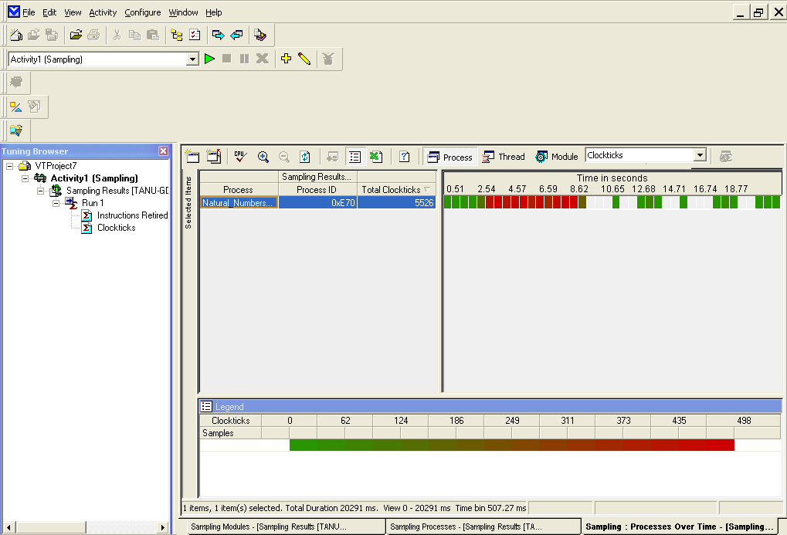
Using Sampling (Contd.)
Sampling over time view shows the threads running during data collection.
It displays the samples collected with respect to time for a single event.
Notes:
Initiate the discussion about Sampling Over Time view by explaining the students that the sampling view shows the threads running during data collection but Sampling Over Time view shows the threads ran in parallel or serially.
The Sampling Over Time view displays the samples collected with respect to time for a single event.
The Sampling Over Time view also enables to identify when and which threads are running serially and in parallel.
Explain the students that Sampling Over Time view can be invoked for Thread, Process, and Module views.
Explain the students that they can perform Sampling Over Time view for different views by selecting an event and clicking on the Display Over Time View icon in the sampling toolbar. After that they need to click on Process, Thread, or Module view.
You can view the samples collected for the selected items over the entire period of time the activity executed.
The Sampling Over time view consists of two panels: the left and the right pane.
The left panel displays the names of the selected items and the right panel displays the samples collected over time.

Slide 13
Using Sampling (Contd.)
You can use the Over Time view to gather the following information:
  Context switching: Enables you to determine if there is excessive context switching
  Processor utilization: Enables you to identify which processors are idle at what times
  Temporal location of hotspots: Enables you to view the specific periods of time when a large number of events occurred
  Thread interaction: Enables you to view the number of threads in an application but not how they interact with each other
Notes:
Explain the students that the Over Time view to gather the following information:
Processor utilization: Enables you to identify which processors are idle at what times. Also explain the students that a processor is idle if Clockticks samples are collected for the System Process or idle thread.
Temporal location of hotspots: Enables you to view the specific periods of time when a large number of events occurred.
Thread interaction: Enables you to view the number of threads in an application but not how they interact with each other.
While explaining these to the students give the example that a significant number of cache misses may occur in the second half of the workload and no cache misses in the first half. If you notice a temporal hotspot such as this one, you can select this area, click Zoom In, and click Display Regular Sampling View for Selected Time-range to drill-down to the specific area of the sampling view where there were a lot of cache misses.

Slide 14
Just a minute
Which wizard in sampling allows you to create an Activity and configure the sampling collector to profile any type of application?
Answer:
  Sampling wizard

Slide 15
Activity: Performing Event-Based Sampling – 1
Problem Statement:
  John has created an application in Java which involves the use of a two-dimensional matrix. However, he finds that his application takes a long time to execute. Therefore, John decides to analyze the performance of the application using the event-based sampling (EBS) feature of VTune Performance Analyzer. Help John accomplish this task.
Notes:
To demonstrate this activity, you can use the data files provided at the following locations:
TIRM → Datafiles for Faculty → Chapter4 → Activity1 → Matrix Class.zip
Matrix Class.zip file contains the optimized and the unoptimized codes. The faculty should first show the demonstration of the unoptimized code. After analyzing the sampling results, the faculty should again run the activity using the optimized code. This would enable the students comparing the sampling results between the optimized and the unoptimized code.

Slide 16
Activity: Performing Event-Based Sampling – 1 (Contd.)
Solution
  To analyze the performance of the application using EBS, you need to perform the following tasks:
    Configure EBS using the Sampling wizard.
    Analyze sampling results.
Notes:
To demonstrate this activity, you can use the data files provided at the following locations:
TIRM → Datafiles for Faculty → Chapter4 → Activity1 → Matrix Class.zip
Matrix Class.zip file contains the optimized and the unoptimized codes. The faculty should first show the demonstration of the unoptimized code. After analyzing the sampling results, the faculty should again run the activity using the optimized code. This would enable the students comparing the sampling results between the optimized and the unoptimized code.

Slide 17
Summary
In this chapter, you learnt that:
  Intel VTune Performance Analyzer is a powerful and
  easy-to-use software-analysis tool.
  VTune Performance Analyzer helps you identify and locate the area of code in an application that shows the highest amount of activity over a specific period.
  VTune Performance Analyzer displays how an application interacts with the OS or other software.
  VTune Performance Analyzer provides a number of features, which make it an efficient performance analysis tool. The features are:
    Sampling
    Call graph
    Counter monitor
    Tuning assistant
    Hotspots view
Notes:
Summarize the session.

Slide 18
Summary (Contd.)
  VTune Performance Analyzer provides flexible user interfaces to manage and organize different windows.
  Sampling is a process of collecting and testing a set of data for relevant information and presenting the analyzed data in statistical format.
  Sampling helps you:
    Identify hotspots
    Identify bottlenecks
  VTune Performance Analyzer provides two types of sampling mechanisms to collect data. They are:
  Time-based sampling (TBS): In TBS, the VTune Performance Analyzer collects samples of an activity at regular intervals of time.
  Event-based sampling (EBS): In EBS, the VTune Performance Analyzer collects samples of an activity at regular intervals of processor event.
Notes:
Summarize the session.

